Slide 1
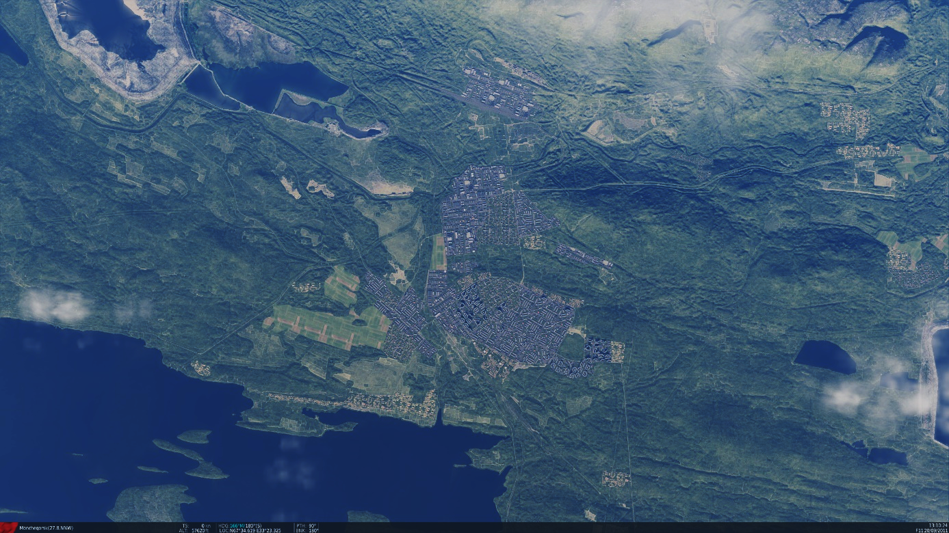
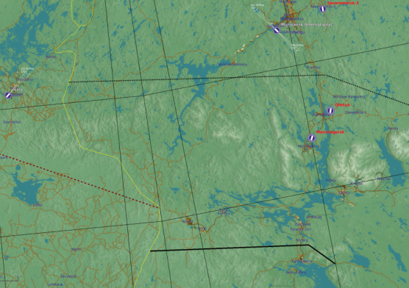


SRNTGT071 Apatite Vehicle Factory
SRNTGT071
N
N 67 34.210 E 033 22.027 - 500 ft -
Apatite Veichle Factory
DESCRIPTION OF THE DESIRED POINTS OF IMPACT
N 67 34.193 E 033 22.115,SRNTGT071 -A: Production facility
N 67 34.224 E 033 21.999,SRNTGT071 -B: Power for production hall
N 67 34.237 E 033 21.986,SRNTGT071 -C: Backup power
N 67 34.215 E 033 21.934,SRNTGT071 -D: Fuel

Slide 2
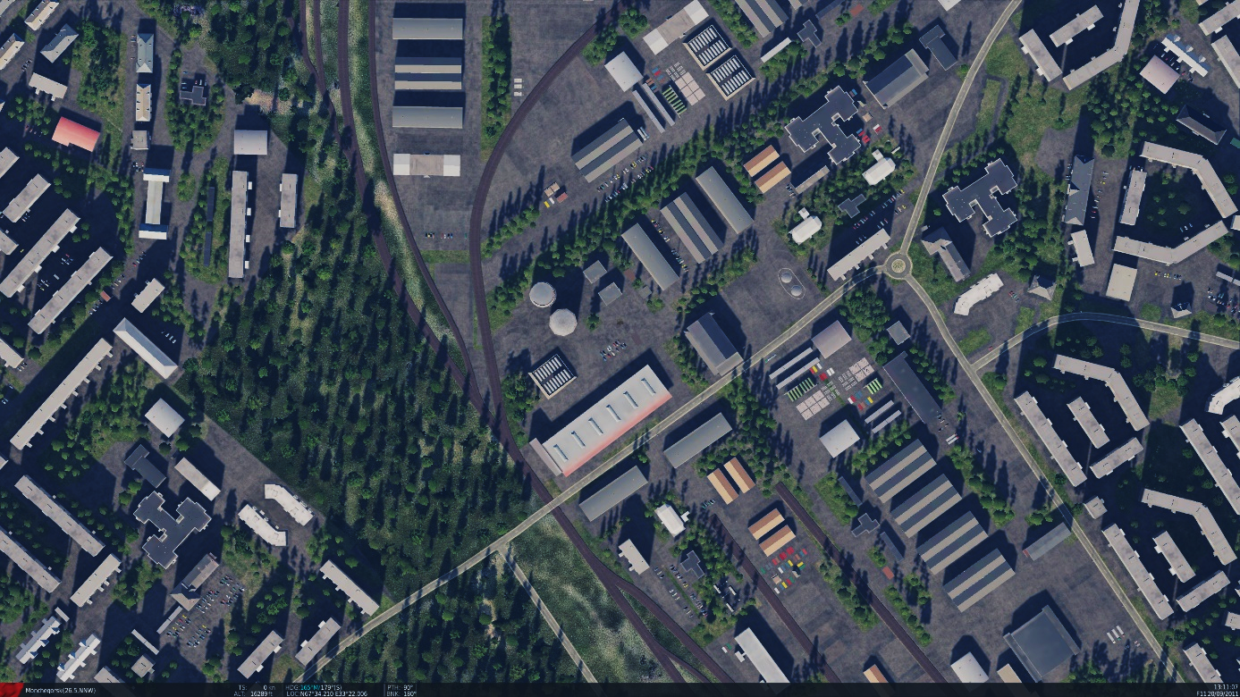
SRNTGT071 Apatite Vehicle Factory
Weapon type needed SRNTGT071
SRNTGT071 -A: Production facility – This building houses key machinery that is hard to replace – destruction will disable production immediately for weeks. 4x500 lbs. OR 1x 2,000lbs weapon needed
SRNTGT071 -B: Power for production hall
Concrete building, with surrounding trees from N-W, impact angle 45°or greater is required FROM directions 240° towards north to 060° At least 1x1,000 lbs weapon needed for desired effect or 1x2,000lbs
SRNTGT071 -C: Backup power
Concrete building. At least 1x1,000 lbs weapon needed for effect or 1x2,000lbs
SRNTGT071 -D: Fuel
1x2,000 lbs weapon needed
SRNTGT071C
SRNTGT071B
N
SRNTGT071D
SRNTGT071A
DESCRIPTION OF THE DESIRED POINTS OF IMPACT
N 67 34.193 E 033 22.115, - 512 ft - SRNTGT071 -A: Production facility
N 67 34.224 E 033 21.999, - 505 ft - SRNTGT071 -B: Power for production hall
N 67 34.237 E 033 21.986, - 505 ft - SRNTGT071 -C: Backup power
N 67 34.215 E 033 21.934, - 500 ft - SRNTGT071 -D: Fuel

